Slide 1
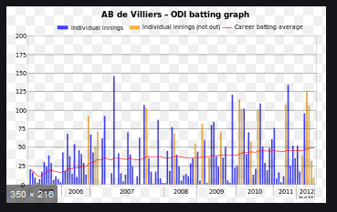
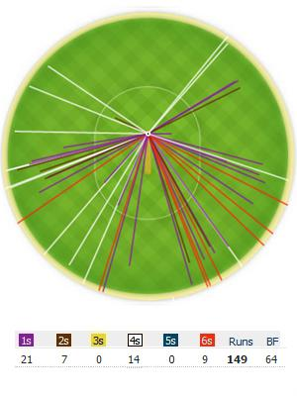
The Power of Statistics: Cricket as a Case Study
Statistics is the science that deals with methodologies to gather, review, analyse and draw conclusions from data. It's a tool we use knowingly or unknowingly in various real-world scenarios.

Slide 2
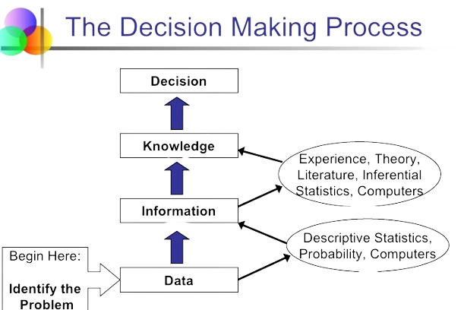
Introduction to Statistics
Definition:
Statistics is the process of collecting, organizing, analyzing, interpreting, and presenting data to understand patterns and make informed decisions
The importance and significance of statistics lie in its ability to:
Informs decisions.
Manages uncertainty.
Spotlights trends.
Aids research.
Ensures quality.
Shapes policies.
Drives business.
Guides healthcare

Slide 3
Types of Statistics
There are two main types of statistics:
Descriptive Statistics:
Involve summarizing and presenting data to describe its main features.
This includes measures such as mean, median, mode, range, variance, and standard deviation.
Descriptive statistics are used to gain insights into data and understand its characteristics.
Inferential Statistics:
Involve making predictions, inferences, or generalizations about a larger population based on a sample of data. I
includes techniques like hypothesis testing, confidence intervals, and regression analysis. Inferential statistics help us draw conclusions beyond the data we have collected.
These two types of statistics work together to help us analyze and understand data in a comprehensive manner.

Slide 4
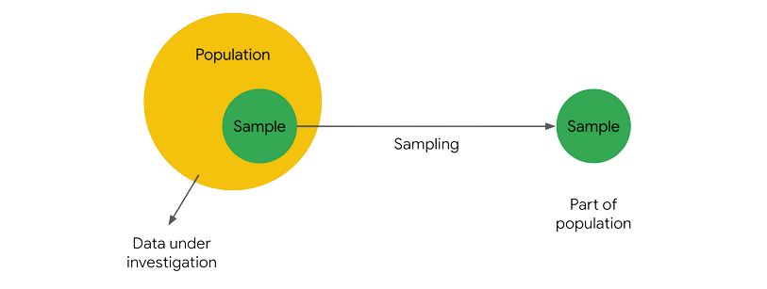
Population Vs Sample
Population:
The entire group you want to study.
Example: All households in a country for studying average income.
Sample:
A smaller, representative subset from the population.
Example: Surveying a selected group of households to estimate average income, saving time and resources.

Slide 5
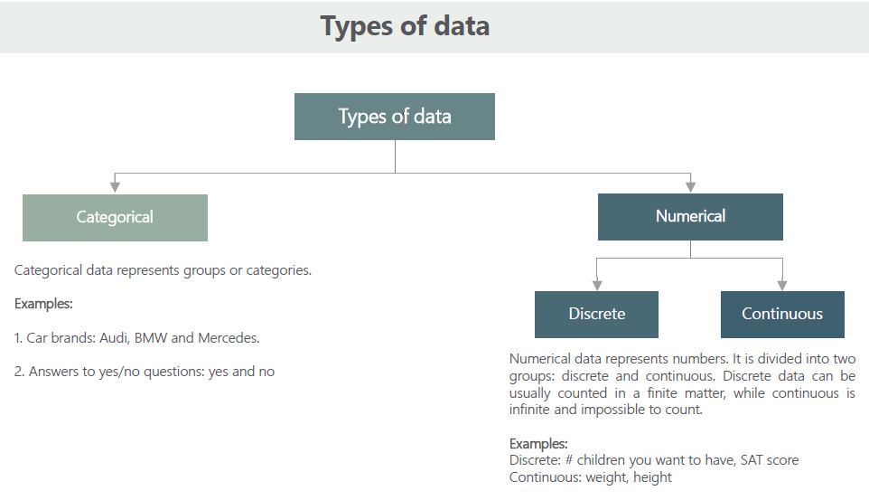
Types of Data

Slide 6
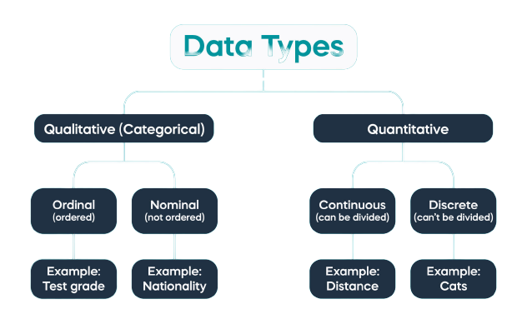
Types of Data

Slide 7
Descriptive Stats
Measure of Central Tendency
Measure of Central Dispersion
Mean
Range
Median
Standard Deviation
Mode
Variance
Interquartile Range (IQR)

Slide 8
Measure of Dispersion
Mean (Average):
Definition: The mean is the sum of values divided by the count of values.
Example: For the numbers 3, 5, and 7, the mean is (3 + 5 + 7) / 3 = 5.
Median:
Definition: The median is the middle value when data is ordered.
Example: In the dataset 10, 20, 30, 40, 50, the median is 30.
Mode:
Definition: The mode is the most frequent value in a dataset.
Example: In the dataset 5, 8, 8, 10, 12, 12, 12, the mode is 12 as it appears most frequently.

Slide 9
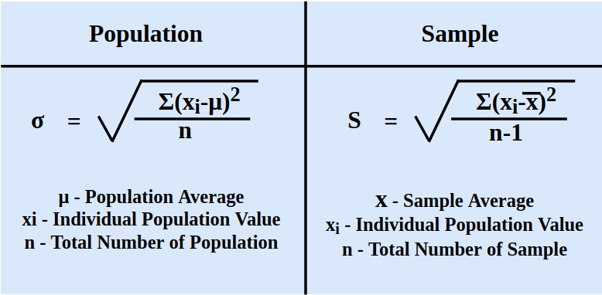
Measure of Dispersion
Range:
Definition: The range is the difference between the highest and lowest values in a dataset.
Example: In the dataset {10, 15, 20, 25, 30}, the range is 30 - 10 = 20.
Standard Deviation:
Definition: The standard deviation is the square root of variance, quantifying data spread around the mean.
Example: In {12, 15, 18, 21, 24}, the standard deviation is approximately 4.5.

Slide 10
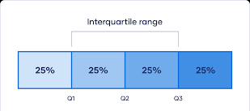
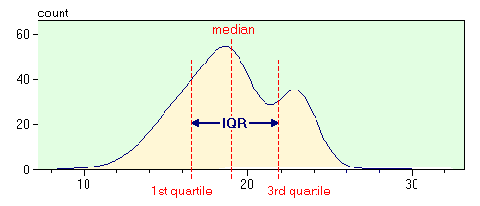
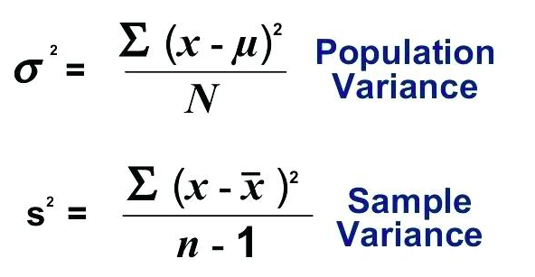
Measure of Dispersion
Variance:
Definition: Variance measures how data points differ from the mean by averaging the squared differences from the mean.
Example: In the dataset {5, 10, 15, 20, 25}, the variance is approximately 41.67.
Interquartile Range (IQR):
Definition: IQR is the range between the 75th and 25th percentiles, measuring the spread of the middle 50% of data.
Example: In {10, 20, 30, 40, 50}, the IQR is 40 - 20 = 20.

Slide 11
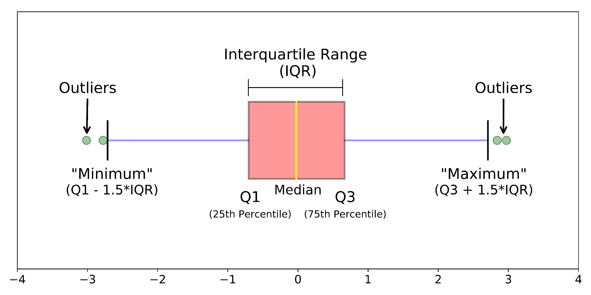
Measure of Dispersion

Slide 12
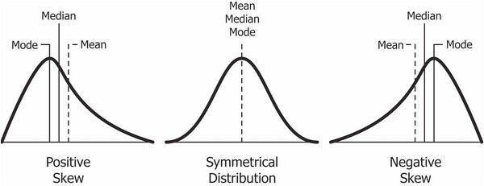
Skewness
Skewness is asymmetry in a statistical distribution, in which the curve appears distorted or skewed either to the left or to the right. Skewness can be quantified to define the extent to which a distribution differs from a normal distribution.
When a distribution is skewed to the left, the tail on the curve's left-hand side is longer than the tail on the right-hand side, and the mean is less than the mode. This situation is also called negative skewness.
When a distribution is skewed to the right, the tail on the curve's right-hand side is longer than the tail on the left-hand side, and the mean is greater than the mode. This situation is also called positive skewness.

Slide 13
How skewness affects data interpretation
Skewness indicates the direction (positive or negative) of data imbalance.
It helps identify the presence of outliers or extreme values in the data.
Skewed data can impact the choice between mean and median as a measure of central tendency.
Skewness guides decisions on data transformation or analysis methods for more accurate insights.

Slide 14
Coefficient Of Variation (CV)
The coefficient of variation (CV), also known as relative standard deviation (RSD), is a standardized measure of dispersion of a probability distribution or frequency distribution.
It is often expressed as a percentage, and is defined as the ratio of the standard deviation(σ) to the mean(μ). It gives the measure of variability
CV = Standard Deviation / Mean

Slide 15
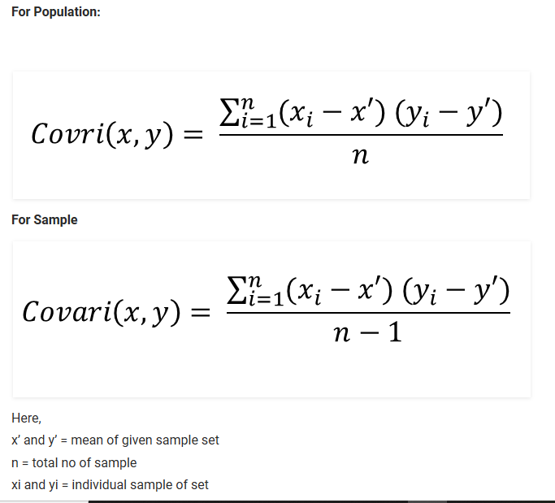
Covariance
It is method to find the variance between two variables.
It is the relationship between a pair of random variables where change in one variable causes change in another variable.
It can take any value between -infinity to +infinity, where the negative value represents the negative relationship whereas a positive value represents the positive relationship.
It is used for the linear relationship between variables.
It gives the direction of relationship between variables.
It has dimensions.

Slide 16
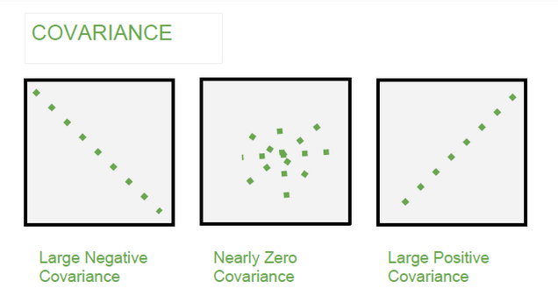
Covariance Relationship

Slide 17
Correlation
* It shows whether and how strongly pairs of variables are related to each other.
* Correlation takes values between -1 to +1, wherein values close to +1 represents strong positive
* correlation and values close to -1 represents strong negative correlation.
* In this variable are indirectly related to each other.
* It gives the direction and strength of relationship between variables.
* It is the scaled version of Covariance.
* It is dimensionless.

Slide 18
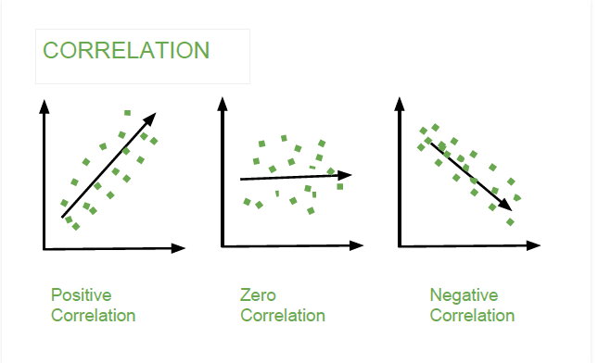
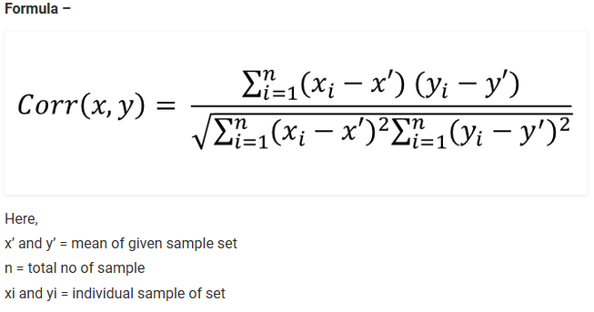
Correlation Relationship

Slide 19
Central Limit Theorem
Central Limit Theorem:
The Central Limit Theorem (CLT) is a fundamental concept in statistics that states the following:
"When independent random variables are added together, their properly normalized sum tends toward a normal distribution (a bell-shaped curve), regardless of the shape of the original random variables' distributions."
In other words, as you take larger and larger samples from a population and calculate the means (or sums) of those samples, the distribution of those sample means will approach a normal distribution, even if the population itself is not normally distributed.

Slide 20
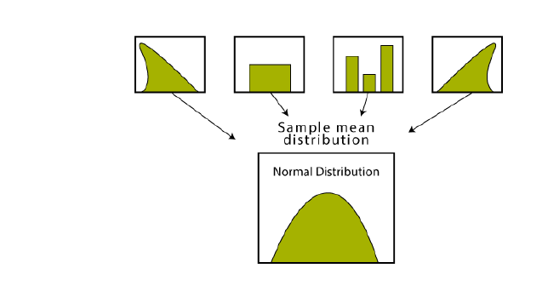
Central Limit Theorem
Imagining an experiment may help you to understand sampling distributions:
Suppose that you draw a random sample from a population and calculate a statistic for the sample, such as the mean.
Now you draw another random sample of the same size, and again calculate the mean.
You repeat this process many times, and end up with a large number of means, one for each sample.
The distribution of the sample means is an example of a sampling distribution.
The central limit theorem says that the sampling distribution of the mean will always be normally distributed, if the sample size is large enough.
Regardless of whether the population has a normal, Poisson, binomial, or any other distribution, the sampling distribution of the mean will be normal.​

Slide 21
